Slide 1



INTEGRATED Marketing Communications
Reminding
Informing
Persuading

Slide 2
Definition
Integrated Marketing Communication…..
is a process for planning, executing & monitoring the brand messages that create customer relationships
A comprehensive plan that evaluates the strategic roles of a variety of communication disciplines and combines these disciplines to provide clarity, consistency , and maximum communication impact.

Slide 3
Benefits of IMC
1. Decreases complexity and improves efficiency:
You can decrease the complexity of your marketing campaign using integrated marketing communication. It helps you to streamline your process. All you have to do is, decide an efficient approach to be implemented across various channels. This eliminates the need for creation of various resources for different spins of the campaign. In other words, you can utilise the same imagery and messages throughout and cut down on planning, meetings and resources, thus, using all of them efficaciously.
2. Clears the message that you want to convey:
Marketing is meant for introducing your products and services to the target audience and convincing them to buy from you. But, just forcing your ideas every now and then that too in a haphazard manner creates confusion among the customers.In other words, if your marketing campaign is inefficient, it is very easy for customers to miss the point you are trying to make. Therefore, you need to pull your campaign together into a combined one that provides a clear vision of your objectives and conveys your message effectively. This will help your customers have a much clearer view of you as a company and will be more likely to react in a way that you desire.
3. Deflates operational costs:
Since, photography, graphics and content are costly to any business, so, there is a need to consider strategies that cut down the cost incurred on the same. One of the best possible solution is integrating your campaign. This will eliminate the need for duplication as it enables you to share across channels. Thus, integrated marketing communication saves your time as well as money.

Slide 4
Benefits of IMC
Increases the morale:
Integrated marketing campaign helps your business internally. This is because, when you run an integrated campaign your team have to pull together, share talent and stay on top of communication to ensure consistency. Thus, IMC actually helps boost team morale. Moreover, the work done to integrate across various channels will train them appropriately to master the campaigns to be held in near future.
Helps instill trust within target audience:
Integrated marketing communication enables you to integrate your messages and keep them consistent and hence, strengthen your campaign further. This instills trust within your target audience. Thereafter, they tend to give you the benefit of the doubt and click on the very enticing link that you have provided them with. Thus, IMC actually helps you to accomplish your call to action.
It makes your campaign more effective:
Utilizing integrated marketing campaign makes your campaign more persuasive and effective. When you communicate consistently through a variety of channels, you reinforce your message. This makes your message more powerful. makes your message more powerful. The consistency of your message raises brand awareness and trust

Slide 5








growth of imc
Old World New World
“Talking to” Consumers
Two-way Dialogue With Consumers
Focus on Winning New Customers
Focus on Building Long Term Relationships With existing Consumers
Marketers Relied Primarily on Advertising and Promotions
Marketers Use and Coordinate Many Different Forms of Communication With Consumers
8

Slide 6
growth of imc
Old World New World
consumers receive whatever the
networks broadcast
Empowered media users control & shape the content ( Thanks to internet)
Aspirations were to keep up with
the crowd
Aspirations are to stand out from the
crowd

Slide 7
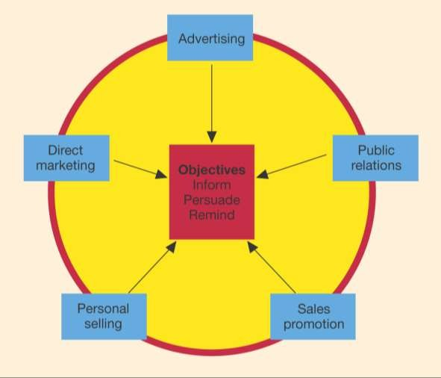
The PROMOTIONAL Mix

Slide 8
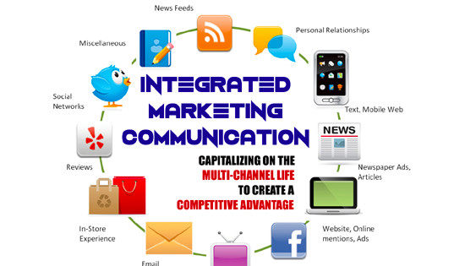
Integrated Marketing Communications

Slide 9
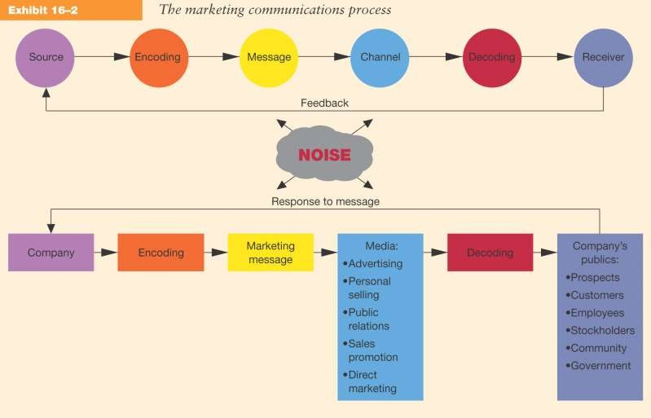
MARKETING COMMUNICATION PROCESS

Slide 10
IMC Planning process

Slide 11
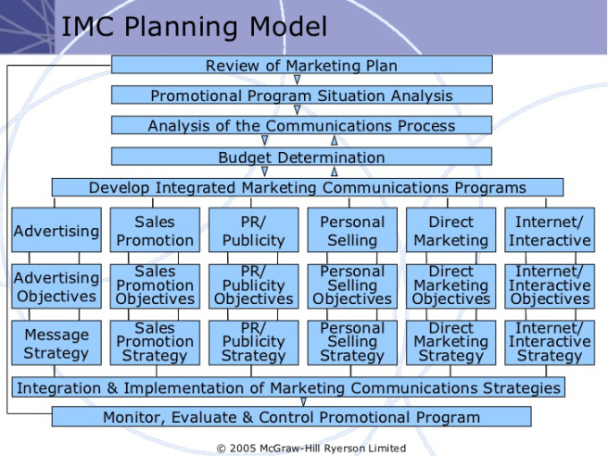

Slide 12
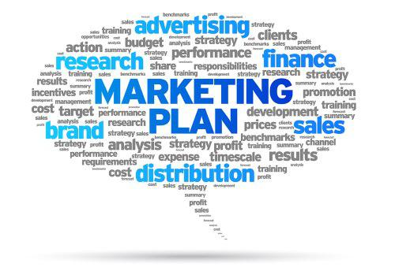
1) Review of marketing plan & objectives
Where the company/ brand:-
>has been >is (current position) > intends to go
How the company/ brand plans to get there.
Marketing plan is a written document that describes the overall marketing strategy & programs developed for an organization, a particular product line or a brand.
Notes:
Smart – specific measurable attainable relevent time bound

Slide 13
Basic Elements Of A Marketing Plan
A detailed situation analysis of internal and external analysis of market.
Specific marketing objectives
A marketing strategy and program including selection of target market and elements of marketing mix.
A program for implementing the marketing strategy including tasks and responsibilities
A process for monitoring and evaluation performance and providing feedback.

Slide 14
areas covered in Situation Analysis
Internal Factors | External Factors
Assesment of firm’s promotional organization and capabilities Review of firm’s previous promotional programs & results Assesment of firm or brand image & implications for promotion Assesment of relative strengths & weaknesses of product or service | customer analysis Competitive analysis Enviromental analysis

Slide 15



Communications Process Analysis
Set Marketing Objectives
Set communication objectives

Slide 16
Budget Determination
Two basic questions are asked :-
1) what will the promotional program cost?
2) how will the money be allocated?
Influences on Budgeting:
Size of the company
Its financial resources
The type of business
The market dispersion
The industry growth rate
The firm’s position in the marketplace

Slide 17
Developing the imc program
Explicit Communications:
Convey a distinct, clearly stated message through personal selling, advertising, public relations, sales promotion, direct marketing, or some combination of these methods.
Implicit Communications:
What the message connotes about the product itself, its price, or the places it is sold.

Slide 18
Monitoring, Evaluating, and Controlling
Monitor sales promotion by the number of coupons redeemed.
Measure the effectiveness of a new personal selling strategy by looking at the number of new accounts opened.
A firm might run tests to see it consumers noticed the ad.
Review sales results and attribute fluctuations in sales volume to MC.

